Slide 1

Cracking WPA/WPA2 Wi-Fi routers
Introduction to secure wireless network hacking!

Slide 2

About Me
Mohit Katta
BSc Computer Systems @ Heriot-Watt university, Dubai campus
Interested in Cybersecurity, Design and AI.

Slide 3
Before we start...
DISCLAIMER
This is STRICTLY for educational purposes. Try it at your own or authorized networks.
DO NOT TRY THIS with unauthorized networks.

Slide 4



Wireless Interface modes
Monitor Mode : Reconnaissance of networks.
Managed Mode : Not much to explain.

Slide 5


What is a 4-way handshake?
WPA/ WPA 2 uses a 4-way handshake to authenticate devices to the network.
Access Point (AP)
Station

Slide 6
What is a 4-way handshake?
WPA/ WPA 2 uses a 4-way handshake to authenticate devices to the network.
Access Point (AP)
Station
1
2
3
4
Station sends a hash to the AP to crosscheck.

Slide 7
What is a 4-way handshake?
WPA/ WPA 2 uses a 4-way handshake to authenticate devices to the network.
Access Point (AP)
Station
1
2
3
4
AP sends Identification Key to station

Slide 8
What is a 4-way handshake?
WPA/ WPA 2 uses a 4-way handshake to authenticate devices to the network.
Access Point (AP)
Station
1
2
3
4
Station makes Special ID using Identification Key from the previous step and sends to AP.

Slide 9
What is a 4-way handshake?
WPA/ WPA 2 uses a 4-way handshake to authenticate devices to the network.
Access Point (AP)
Station
1
2
3
4
With Special ID, AP makes Temporary Key and sends to station, to obtain the network.

Slide 10
That was the theory part!
Let’s get to the fun part!

Slide 11
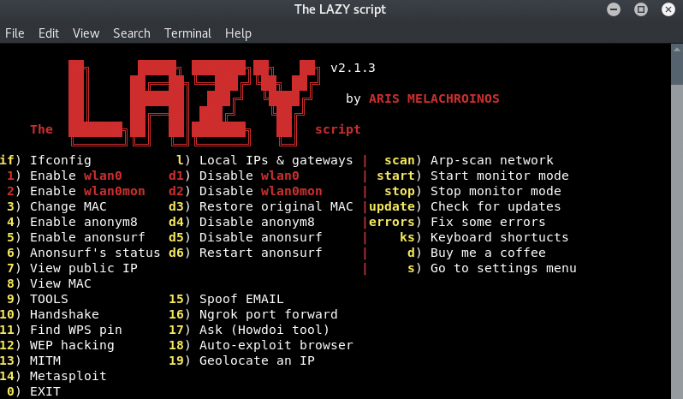
Installation process for all the scripts
Using the LAZY Script.

Slide 12
How do we start the crack
WPA/WPA2 Handshake using AIRMON-g
De-authenticate users to get the (.cap) file using aireplay-ng or mdk3
Auto-check for WPA Handshake
Integrity check
Brute force the password using a basic dictionary-based attack (Aircrack-ng)

Slide 13
How do we start the crack
WPA/WPA2 Handshake using AIRMON-g
De-authenticate users to get the (.cap) file using aireplay-ng or mdk3
3. Auto-check for WPA Handshake
4. Integrity check
Brute force the password using a basic dictionary-based attack
(Aircrack-ng)

Slide 14
WPA/WPA2 Handshake using AIRMON-g
Access Point (AP)
Station
THE HACKER

Slide 15
How do we start the crack
WPA/WPA2 Handshake using AIRMON-g
De-authenticate users to get the (.cap) file using aireplay-ng or mdk3
Auto-check for WPA Handshake
Integrity check
Brute force the password using a basic dictionary-based attack (Aircrack-ng)

Slide 16
How do we start the crack
WPA/WPA2 Handshake using AIRMON-g
De-authenticate users to get the (.cap) file using aireplay-ng or mdk3
Auto-check for WPA Handshake
Integrity check
Brute force the password using a basic dictionary-based attack (Aircrack-ng)

Slide 17
How do we start the crack
WPA/WPA2 Handshake using AIRMON-g
De-authenticate users to get the (.cap) file using aireplay-ng or mdk3
Auto-check for WPA Handshake
Integrity check
Brute force the password using a basic dictionary-based attack (Aircrack-ng)

Slide 18
Let’s go ahead with the crack!
Read the disclaimer in the description below!

Slide 19
Any questions?

Slide 20
If you have any queries regarding this stream or more..
mohit@hwtech.club
Or if you have any general queries regarding Ethical Hacking..
pranav@hwtech.club

Slide 21
Thank You!
See you guys in the next one!

